Slide 1

SchoolCloud
Student Information System
Michetti Information Solutions, Inc.
March 2022

Slide 2




The world of tomorrow will be unimaginably different from today
Exploding demand for the world’s resources requires new innovations and efficiencies
In less than a decade, 77% of jobs will require a technical skill
Automation and AI will replace millions of today’s jobs, while creating new ones
Emotional intelligence will be increasingly crucial for the careers of tomorrow

Slide 3



Tracking today’s students requires a different approach
Even if COVID-19 had not happened, the leaders of tomorrow will be solving problems we can’t identify now – how they approach those problems is more important than what they know.
School administrators in Alberta have more data and tasks to deal with than ever before.
An easy-to-use SIS is essential to the success of your school’s administrators, teachers and ultimately, its students.
A good SIS has above average uptime and outstanding support. SchoolCloud leads the industry in both areas.

Slide 4

Easy to use system means a flat learning curve for administrators and teachers.
Why SchoolCloud for your SIS?
 | What SchoolCloud offers:
Mature, well developed PASI compliant SIS has been in use for 10 years in Alberta. Having access to a familiar, robust, and capable application, SchoolCloud allows administrators to truly unleash their potential as opposed to handle repetitive, mundane tasks. | Ease of use. Always on. Alberta based.
Live, online support or email and telephone support is always available. SchoolCloud has gained a reputation of having the best support in the industry. There is always somebody you can reach out to in order to solve your problem now ! | Incredible support, Data hosted in Alberta
“School Cloud is fantastic !! Our whole company is using it and really loving its versatility! We are loving School Cloud – it is so versatile and the fact that we can access the information anywhere fits perfectly with our model. The support Kelly has been providing has been fantastic.”
    Nicole Rosendorf M.A. (Clin. Psych)
    Executive Director
    Kids Developmental Services Ltd.
    Calgary, AB.

Slide 5
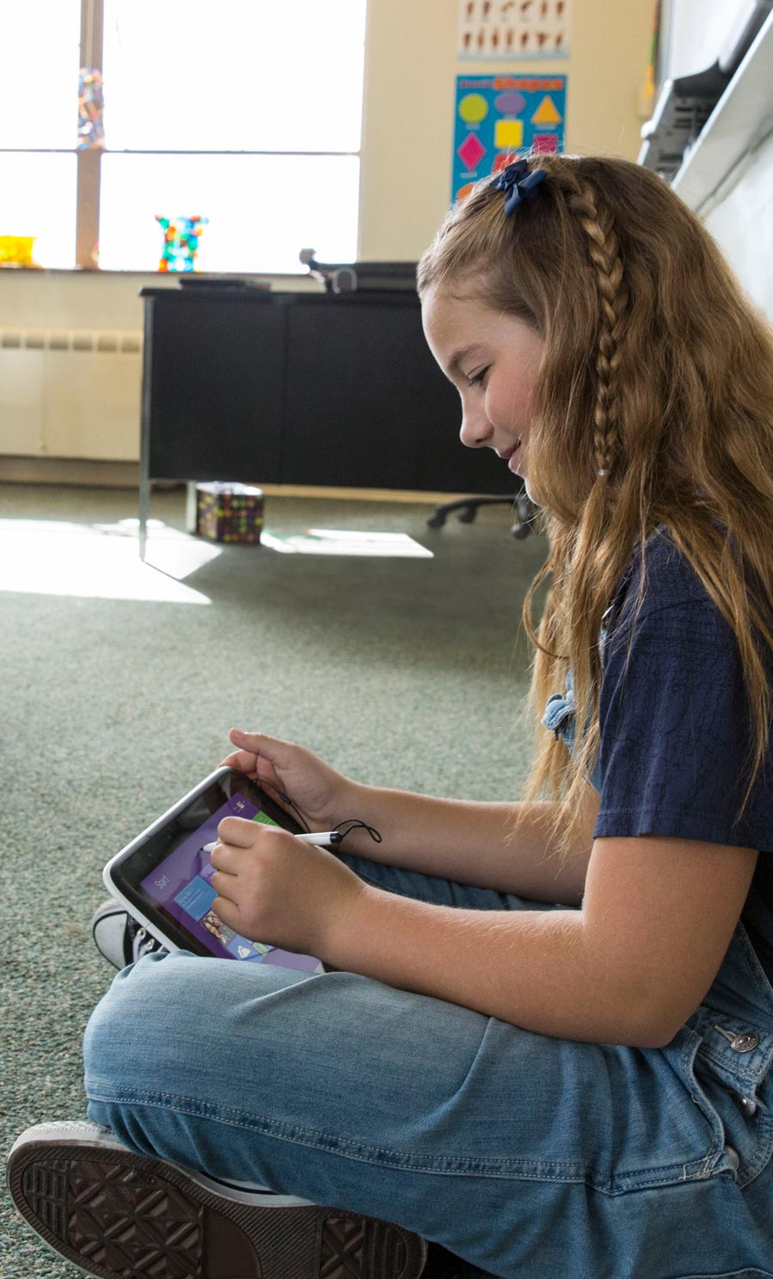
SchoolCloud Basic Features
Administration | Student Information | Student Academic
Over 50 reports User & Permission Management Audit Trail Budgeting Consultant Billing 24/7 Support via Live-Chat Automated Emails & Excel Export Referrals Applications Notes Transportation Family (Parents & Siblings) PASI integration, work Items | Medical Emergency Contact Notes Transportation Family (Parents & Siblings) PASI integration Detailed Medical information Work Items Emergency Contact Detailed Medical information | Attendance Individualized Program Plan Daycare Report Cards Scheduler Assessments(SLP,OT,PT,ASQ) Funding PASI (School Enrollment & High School Marks)
“We have been working with Greg Michetti and his team for almost 10 years and are proud to say we have been chosen as one of the pilot programs. As such, we have seen numerous new features gradually added to the system while being PASI compliant. SchoolCloud SIS is simple and flexible for additional customization with no concerns about data security. We are using multiple features such as online student applications, tracking student attendance, transportation information, IPP’s, documents and assessments uploading, reporting, etc. SchoolCloud saves our staff time and effort while providing accurate data. The online “Chat Live” feature is very helpful for our staff to connect with Kelly M. and his team to ask questions, and they are very supportive in handling and resolving any issues. I have no hesitation in recommending the services of MIS “
    Walter Lidster, Executive Director
    ABC Head Start Society, Edmonton, AB
Notes:
We know teachers spend significant time and energy trying to reach each of these students and create inclusive environments where every student can succeed. Not only do they drive curriculum in core areas like reading, writing and math, they often shoulder the responsibility of ensuring all their students feel safe, secure, have equitable access to learning. Universal design for learning is a flexible framework that enables teachers to approach meeting these diverse needs in a new way. It drives teachers to collaborate with their students in turn driving classroom collaboration. It gives learners multiple ways of acquiring knowledge, taps into learners' interests, and motivates them to assess themselves, driving them to demonstrate what they know. Teachers become facilitators in a learning journey that is student led. We know through research that learner motivation and actual learning increase when learners have a stake and are treated as co-creators in the learning process.3
Meeting the needs of today’s diverse learners and helping them build life skills has never been more important. In a world where 30%-40% of future jobs will require explicit social and emotional skills4 in addition to core knowledge, the role of the educator is critical in helping students build 21st century skills. However, student-centered learning content and approaches are in high demand and low supply.

Slide 6

Future ready improvements are constantly being made to the application to conform to Alberta Education requirements.
SchoolCloud On-Line – Application Forms and more!
Your needs: | SchoolCloud offers:
Easy Admissions Procedure: We put your on-line application form right on your existing website. Once completed by the applicant, it is electronically forward to Admissions and when finalized, can be brought into your SIS with the click of a mouse. | On-line Application Forms speeds up entire process by reducing errors.
Individualized Program Plans (IPP) contain a multitude of fields that adhere to Alberta’s provincial standard and can be entered in by teachers and printed off at their convenience for handing out to the student. | Customizable IPP and PUF forms are part of basic package.
Our new Parent Portal feature is complete, it allows parents to securely access their students profile and ask questions or make comments to instructors. approach. | Easier communication with parent means less time on the phone.
Consultant tracking allows therapists to log into the system from any internet web browser and enter timesheet information for all meetings with students. EG: Jane Doe spent 60 minutes in a FOP/Teach Visit with student Joe at $100/hour rate. Data is imported into Ceridian or other payroll programs. Integration with Sage and QuickBooks accounting is planned for 2021. | Allows for smooth integration of contractors into overall system.
” We are very happy with how everything has turned out and really appreciate the dedication Kelly has given to us! I have nothing but good things to say – I recommended you to another small Calgary school a couple of months ago. If you ever need someone to talk about their experience in setting up a very customized system, I would be happy to sing your praises!”
    - Mrs. Lori Blais Assistant Principal, Clear Water Academy.
Notes:
Microsoft is delivering end-to-end solutions that provide inspiration and access to STEM education for all students. With affordable and free, products, programs, curriculum and support we enable educators with the tools they need to bring STEM to life and promote future ready skills.
Provide educators with tools and training: Microsoft supports educators with professional development they need to gain confidence in teaching STEM content and with a STEM approach. Face to face PD and collaboration with teachers that connect industry to educators in the classroom is vitally important to building long lasting relationships. Platforms like the Microsoft Educator Center, provide an online option that supports educators with the materials and support they need whenever and wherever to help them execute successfully in the classroom.
Partnerships: Microsoft Education partners with leading edge, innovative companies in the STEM space like Kano, microbit and NASA, enabling us to bring a broader set of tools to educators to help ignite the classroom.

Slide 7



Next steps
Teachers
Try out Office 365 for free:
https://www.microsoft.com/en-us/education/products/office
Become part of the Microsoft educator community:
https://education.microsoft.com/
Check out learning tools:
http://edudownloads.azureedge.net/msdownloads/Learning_Tools_research_study_BSD.pdf
Visit your local Microsoft Store for software and hardware guidance
https://www.microsoft.com/en-us/store/locations/find-a-store
Administration
Give us phone call! 780.463.1918 ext 101.
Email us for a demo account: info@michetti.com
Check out the SchoolCloud website for more information including testimonials, and references. www.schoolcloud.ca
Check out Intune for education:
https://www.microsoft.com/en-us/education/intune/default.aspx
Learn more about our parent company, Michetti Information Solutions, Inc. www.michetti.com
Follow SchoolCloud on Twitter
Like SchoolCloud on Facebook

